Slide 1
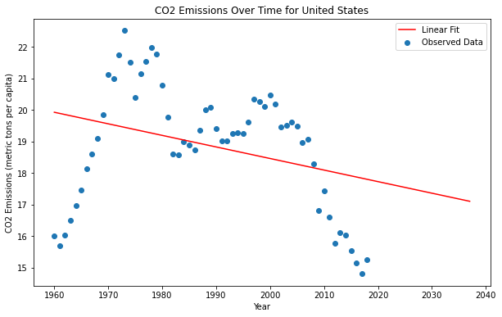
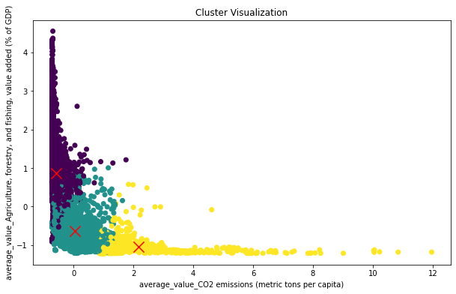
Analysing Global Climate Change Trends Student ID: 22055871
Introduction: Climate change poses one of the most significant challenges of our time, impacting environments, economies, and societies worldwide.
Aim: This analysis aims to dissect the vast array of climate-related data to identify global trends and patterns, enhancing our understanding of this pressing issue
Data Source: Our study leverages the comprehensive 'climate-change.csv' dataset. This rich repository includes diverse metrics from various countries across multiple years.
Methodology: Utilizing Python and the Pandas library, we embarked on a meticulous data analysis journey. The process involved rigorous data cleaning and preprocessing to ensure accuracy and reliability
Literature review:
Agricultural Big Data Analytics (Cravero et al., 2022): uses ML to process various types of data utilizing high-resolution remote sensing and intelligent IT for efficient agricultural analysis under climatic changes.
MT-InSAR in Urban Monitoring (Rodríguez-Antuñano et al., 2022): Combines satellite radar images along with ML to predict urban infrastructure analysis necessary for anticipating structural failures caused by climate change.
ML in Climate System Analysis (Huntingford et al., 2019): Uses ML to study the climate system, especially in identifying complicated feedbacks and predicting severe weather events.
Encoding Methods:
Hashing, Ordinal, One-hot/Dummy, Binary, and Target Encoding techniques used to convert categorical variables.
Decision Tree Classifier used to test the effectiveness
Preliminary Findings
The dataset, displayed in a tabular format, showcases diverse metrics across different countries and years.
A notable observation is the fluctuation in access to electricity over the years, reflecting infrastructural changes and policy impacts.
Changes in agricultural land usage highlight shifting practices and possibly the effects of climate change on arable land.
Next Steps Moving forward, we plan to:
• Integrate more diverse and granular data to enrich our analysis.
• Employ advanced analytical techniques, including machine learning, to delve deeper into the dataset.
• Focus on regional trends to understand localized impacts of climate change.
Data Variables Influencing Bookmaker Selection
Analysis Process
User Demographics:
• Age Range: 18-24 (15%), 25-34 (30%), 35-44 (25%), 45+ (30%)
• Location Distribution: Urban (60%), Suburban (25%), Rural (15%)
• Betting Frequency: Daily (20%), Weekly (50%), Monthly (30%)
Bookmaker Attributes:
• Odds Offered: Competitive (40%), Average (35%), Below Average (25%)
• Promotional Offers: High-Value (30%), Moderate (50%), Low/None (20%)
• User Reviews: Positive (50%), Neutral (30%), Negative (20%)
Data collection
Data Preprocessing
Feature engineering
Model development
Model evaluation
Result analysis
Feedback integration
User Interaction Data:
• Time Spent on Bookmaker Pages: <1 min (20%), 1-5 min (50%), >5 min (30%)
• Click Patterns: Direct (40%), Through Offers (30%), Random (30%)
• Previous Bookmaker Choices: Consistent (60%), Variable (40%)
Results Achieved
References
Cravero, A., Pardo, S., Galeas, P., López Fenner, J. and Caniupán, M., 2022. Data Type and Data Sources for Agricultural Big Data and Machine Learning. Sustainability, 14(23), p.16131.
Rodríguez-Antuñano, I., Martínez-Sánchez, J., Lagüela-López, S. and Riveiro, B., 2022. Towards More Resilient Smart Cities: MT-InSAR Monitoring of Urban Infrastructure Using Machine Learning Techniques. ISPRS Annals of the Photogrammetry, Remote Sensing and Spatial Information Sciences, 10, pp.221-228.
Huntingford, C., Jeffers, E.S., Bonsall, M.B., Christensen, H.M., Lees, T. and Yang, H., 2019. Machine learning and artificial intelligence to aid climate change research and preparedness. Environmental Research Letters, 14(12), p.124007.

